Slide 1

Ahsanullah University of Science and Technology
Department of Computer Science and Engineering
CSE 3104 Project Proposal
Topic: Becha-Kena
By,
Student ID: 20210204032
Student ID: 20210204033
Student ID: 20200204085

Slide 2
Introduction
The database design for our e-commerce website, featuring a unique combination of traditional shopping, bidding, and a self-publishing platform, is fundamental to its success. This presentation covers the database structure, its motivations, requirements, goals, objectives, functionalities, and the development tools and platforms used.

Slide 3
Motivation
The motivation behind developing a robust and efficient database for our e-commerce website stems from the need to effectively manage and scale the platform's operations while ensuring a seamless user experience.

Slide 4
Requirements
To achieve our goals, the database must meet several key requirements:
Scalability: Efficiently manage growing data volumes and user interactions.
Security: Implement measures to protect sensitive user data and transaction details.
Performance: Optimize queries for fast data retrieval and processing.
Data Integrity: Ensure consistent and accurate data across all operations.
Flexibility: Support diverse features such as product listings and user accounts.

Slide 5
Goals
The primary goals for our database design are:
Optimize for high performance, ensuring quick response times.
Maintain robust security and data integrity measures.
Create Something Unique

Slide 6
Objectives
To meet our goals, we have set the following objectives:
Create a normalized database schema to minimize redundancy.
Implement indexing and query optimization techniques.
Facilitate easy maintenance and updates to the database structure

Slide 7
Features
Key features of the database include:
User Accounts and Profiles: Secure storage of user data, profiles, and order history.
Product Listings: Detailed product information, images, and category management.
Order Management: Comprehensive order details, payment information, and status tracking.
Reviews and Ratings: Storing and managing user reviews and product ratings.

Slide 8
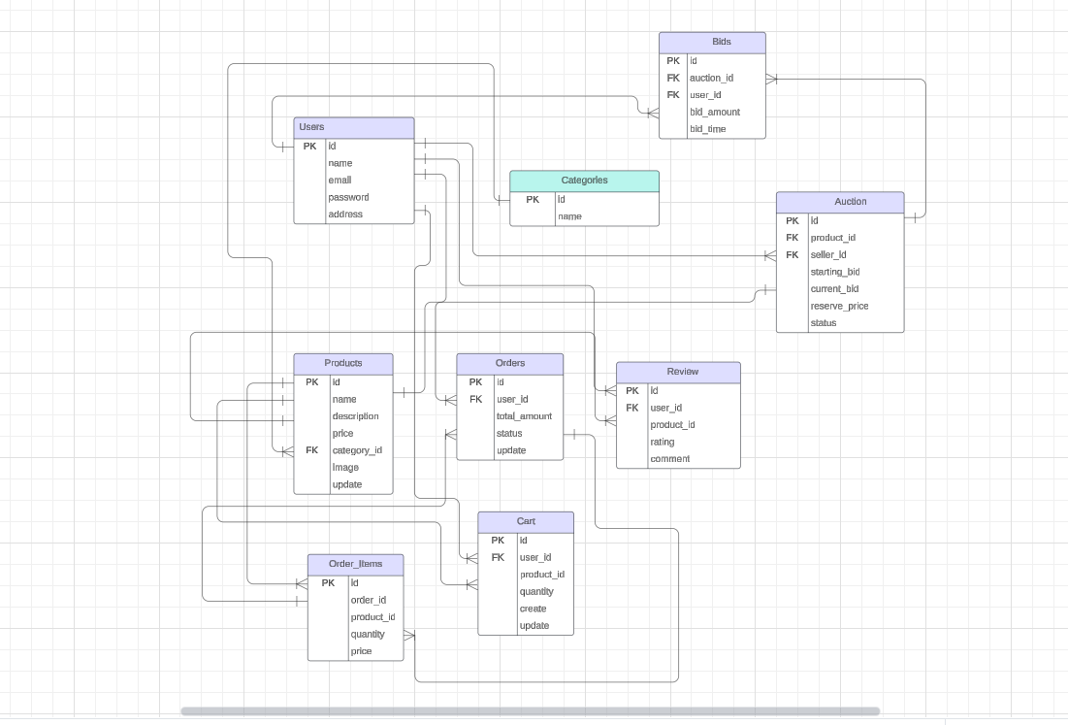
Entity Relationship Diagram

Slide 9
Development Tools and Platforms
The development of our database leverages the following tools and platforms:
Database Management System: MySQL for database management.
Development Environment: PHP for backend scripting, integrated with HTML and CSS for frontend.
Web Server: XAMPP serving web pages and handling HTTP requests.
Version Control: Git for source code management and collaboration, using platforms like GitHub or GitLab.

Slide 10
Thank you

